Slide 1

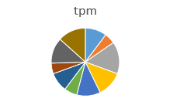
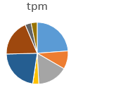
Pool synthesis
Pool cloning
Expression in yeast and pool screening
DNA-binding domain
Activation domain
Reporter
gene
Nuc
Nuc
NGS and analyses
Day 0
Day 4

Slide 2
